Slide 1
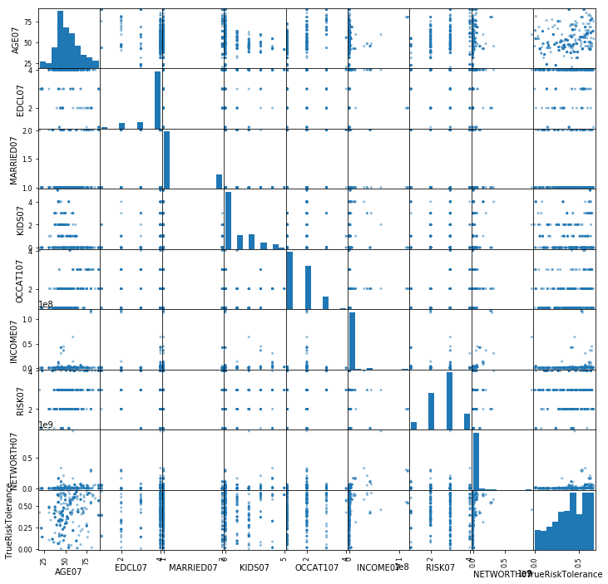
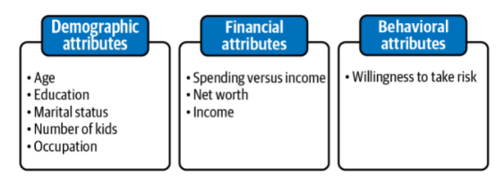
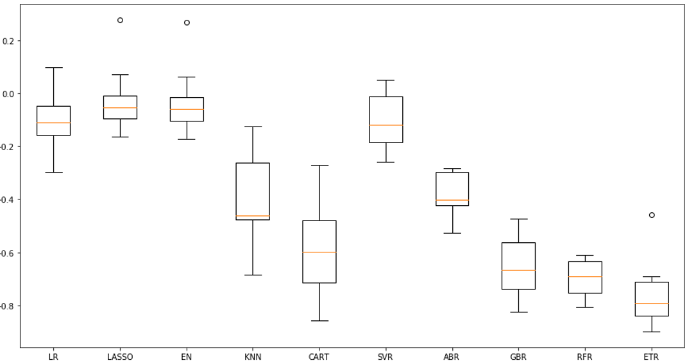
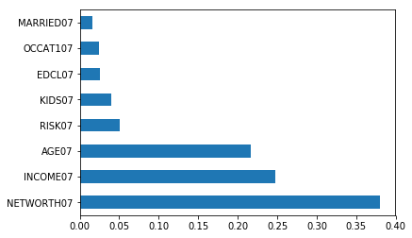
Risk Profiling and Tolerance for the Investor Purpose: By totally removing the client from the process, we were able to develop a machine learning-based Portfolio management system. The overarching goal is to show how machine learning may be used to automate the manual phases in the portfolio management process. Machine learning is also being used to quantify and model investor/individual behavioral bias. | Analysis: Federal Reserve Board's Survey of Consumer Finances (SCF) data which comprises responses from the same group of people in 2007 (pre-crisis) and 2009 (post-crisis).
Procedure: Retaining only the intuitive components from 2007, and exclude all intermediate features and features from 2009, as the variables from 2007 are the only ones needed to forecast risk tolerance. | Results Ensemble methods such as AdaBoost (boosting) and Random Forest (bagging) has best performance with 0.86 and 0.70 mean squared error respectively. .

